Slide 1
Random Forest Classification
Machine Learning with Python

Slide 2
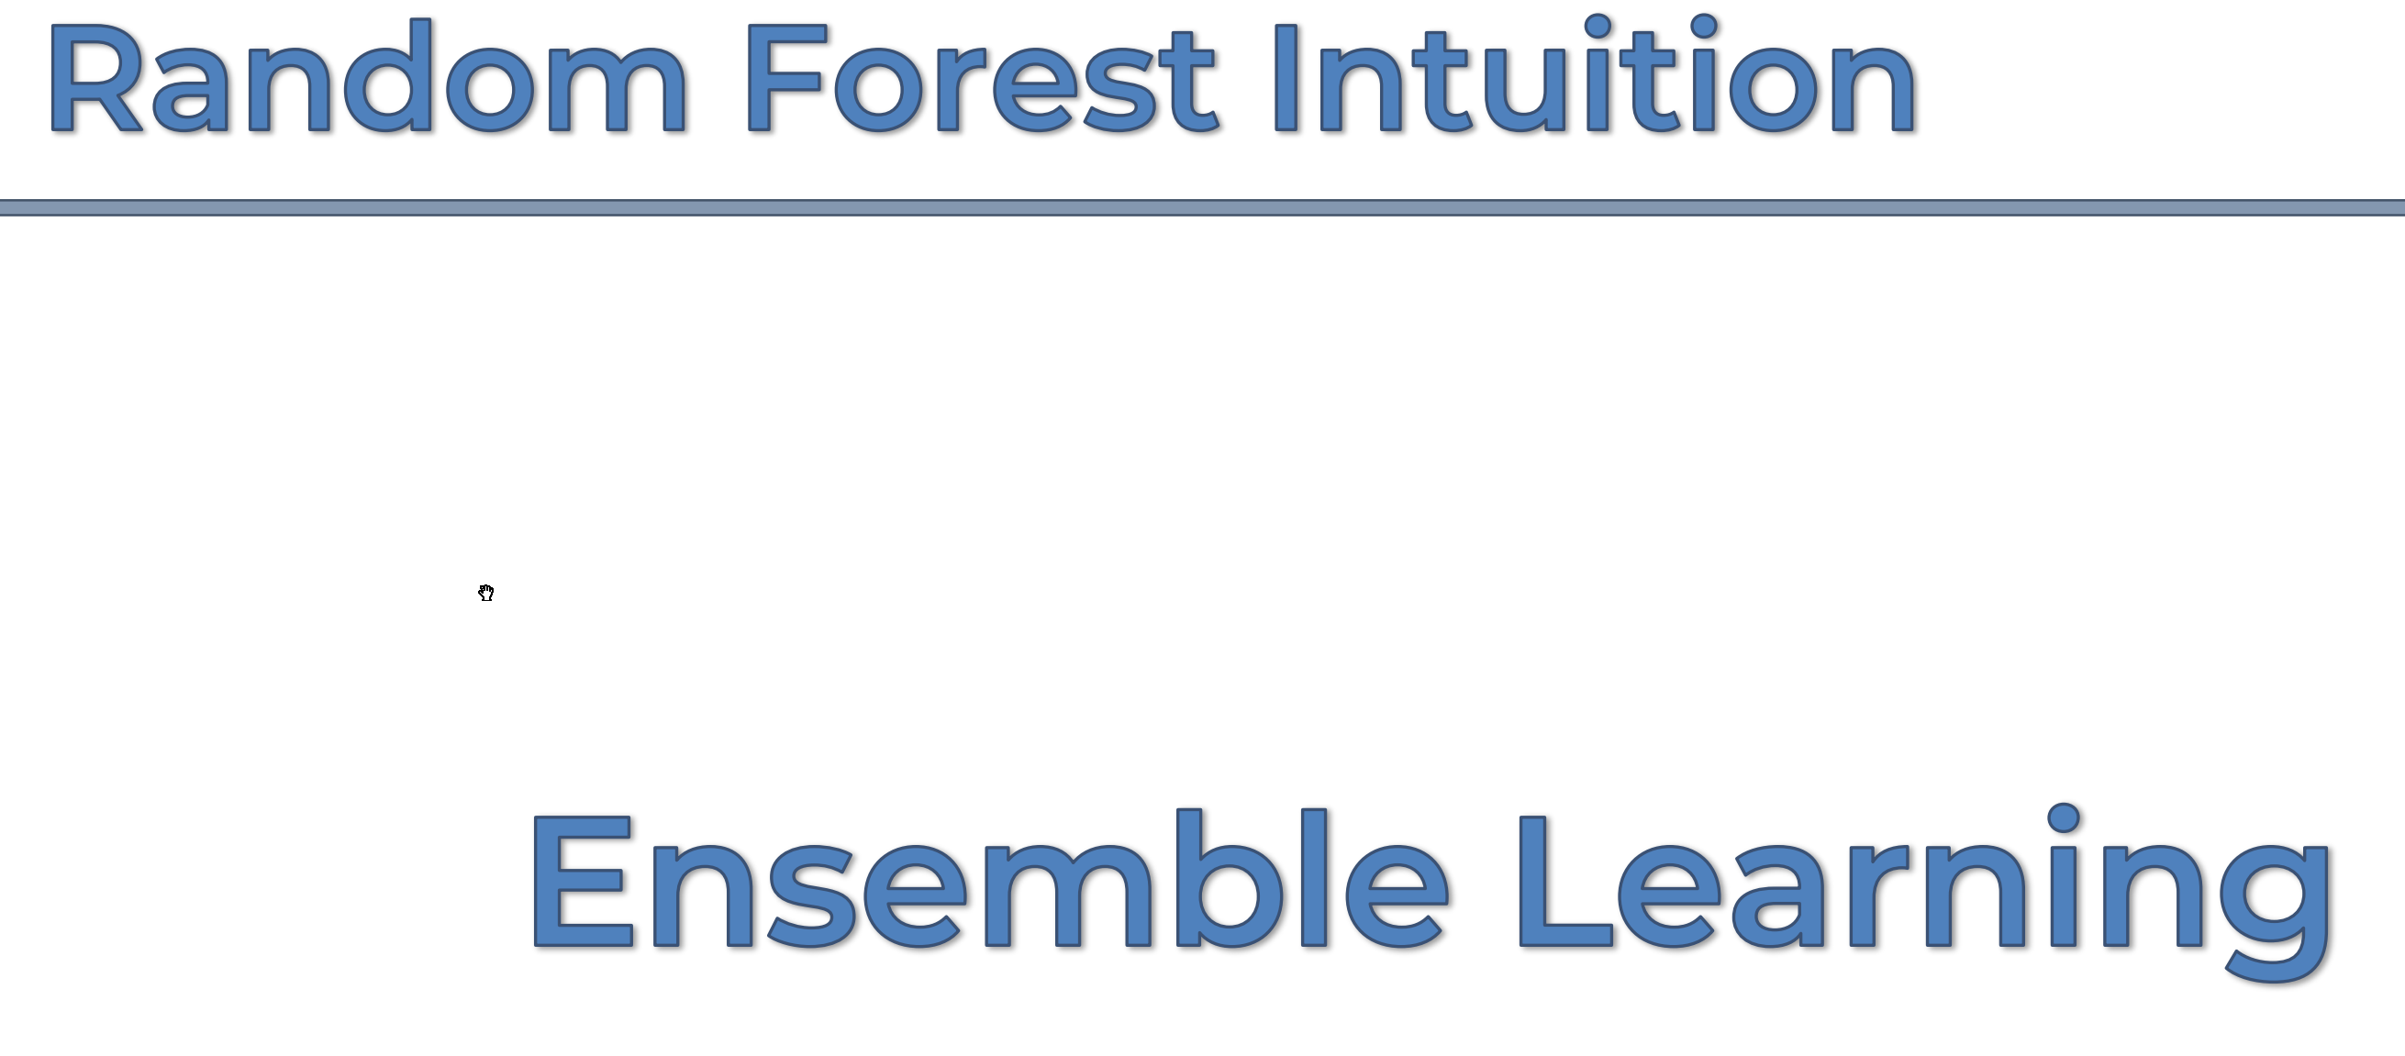

Slide 3
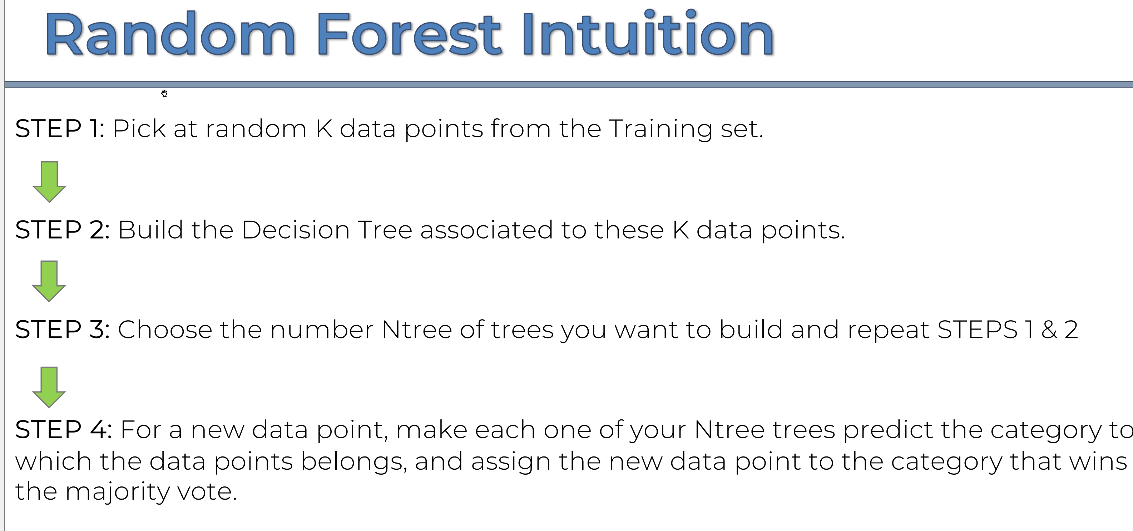

Slide 4


